Slide 1
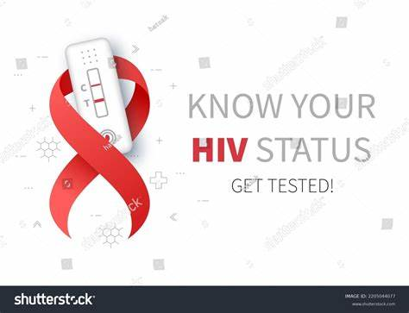
HIV/AIDS
Presenters:
Dr. Subira Mahuna
Dr Rabieth Issae
Facilitator: Prof. Patricia Munseri

Slide 2
OUTLINES:
Introduction
Epidemiology and risk factors
Pathogenesis
Clinical signs and symptoms and complications
Investigation (how to diagnose)
Treatment (ART resistance and treatment failure)
Prevention
HIV & TB

Slide 3
1) INTRODUCTION
What is HIV?
Human Immunodeficiency Virus (HIV) is a retrovirus that infects immune cells (principally CD4+ T lymphocytes), leading to progressive immune deficiency.
Over time, untreated HIV infection can result in Acquired Immunodeficiency Syndrome (AIDS), a state characterized by opportunistic infections, malignancies, and severe immunosuppression.

Slide 4
What is AIDS?
AIDS (Acquired Immunodeficiency Syndrome) is the advanced stage of HIV infection, characterized by severe damage to the immune system, making the body unable to fight infections and certain cancers.
Not every one with HIV has AIDS
AIDS is the end stage of the disease

Slide 5
Historical background
HIV/AIDS originated from zoonotic transmission of simian immunodeficiency viruses jumped from primates to humans in Africa in the early 20th century.
The disease was first recognized in 1981 following reports of unusual opportunistic infections and cancers. HIV was identified as the causative agent in 1983–1984.
Early years were marked by high mortality, stigma, and lack of effective treatment. The introduction of ART’s, especially combination therapy in 1996, transformed HIV into a manageable chronic condition.

Slide 6
Global initiatives expanded access to treatment and prevention. Today, HIV remains a major public health issue, but early diagnosis, effective ART, and preventive strategies have significantly reduced morbidity, mortality, and transmission.
HIV IN TANZANIA.
1st AIDS cases in Tanzania reported in Kagera region in 1983
By December 1985, 20 regions of Tanzania mainland had reported AIDS cases
Since then, progressive increase in the number of cases recorded
HIV-1 is the most isolated serotype worldwide/Tanzania, while HIV-2 mostly found in West Africa.

Slide 7
EPIDEMIOLOGY
Global burden: In 2024 there were about 40.8 million people living with HIV, ~1.3 million new infections, and ~630,000 AIDS‑related deaths.
Since the start of the epidemic an estimated 91.4 million people have been infected and 44.1 million have died.
These headline numbers show both the scale of the epidemic and the gains from treatment expansion.

Slide 8
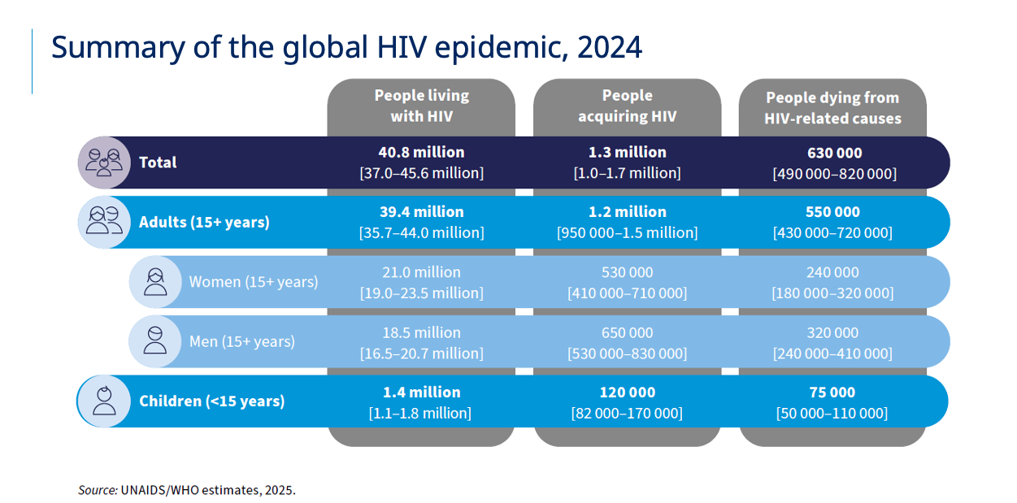

Slide 9
HIV Prevalence is Higher in Sub-groups such as;
men who have sex with men (MSM) (25%) ¹
In people who inject drugs (PWID) (36%)¹
Sex workers (26%)¹
Women are disproportionally more affected, with an HIV prevalence of 6.5% (15-49yrs) versus 3.5% among men aged >15-64years ²
The prevalence of HIV among young people aged 15-19 <2% ²
MTCT 6.5%
Mpondo BCT, Gunda DW, Kilonzo SB. HIV Epidemic in Tanzania: The Possible Role of the Key Populations. AIDS Res Treat. 2017;2017:7089150. doi: 10.1155/2017/7089150. Epub 2017 Aug 17. PMID: 28948049; PMCID: PMC5602645.
Tanzania HIV Impact Survey (THIS) 2022–2023: Final Report. Ministry of Health, 2023.

Slide 10
HIV Prevalence in Tanzania (2024)
The adult HIV prevalence (ages 15–49) in Tanzania is estimated at about 4.4% based on the Tanzania HIV Impact Survey (THIS 2022–2023), which reflects the most current nationally representative data used through 2024.
  This corresponds to roughly 1.5–1.7 million adults living with HIV in the country.
Women have a higher prevalence (~5.6%) than men (~3.0%) among adults aged 15 and older.
The prevalence of ~4.4% represents a continued gradual decline from higher levels seen in past decades (e.g., around 5%–5.1% earlier in the 2010s).

Slide 11
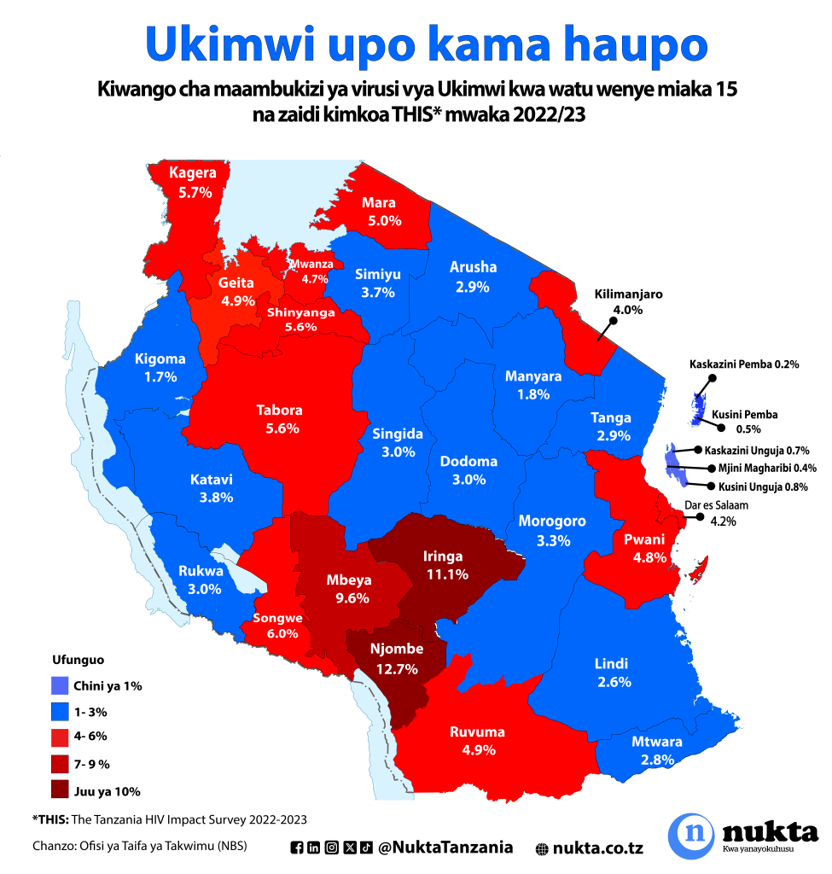

Slide 12
95-95-95 HIV strategies by 2025
WHO, the Global Fund and UNAIDS all have global HIV strategies that are aligned with the SDG target of ending the HIV epidemic by 2030.
By 2025:
95% of all people living with HIV (PLHIV) should have a diagnosis,
95% of those diagnosed should be taking lifesaving antiretroviral treatment (ART)
95% of PLHIV on treatment should achieve a suppressed viral load for the benefit of the person’s health and for reducing onward HIV transmission.

Slide 13
VIROLOGY
Classification
  Family: Retroviridae
  Lentiviruses: HIV 1 & HIV 2 (HIV-1 most common worldwide, HIV-2 West Africa)
HIV-1 can be subdivided into:
  group M (major)
  Group O (outlier)- West-central Africa
  Group N & P (new groups)
9 subtypes for group M lettered A-K(subtype C most common worldwide)

Slide 14
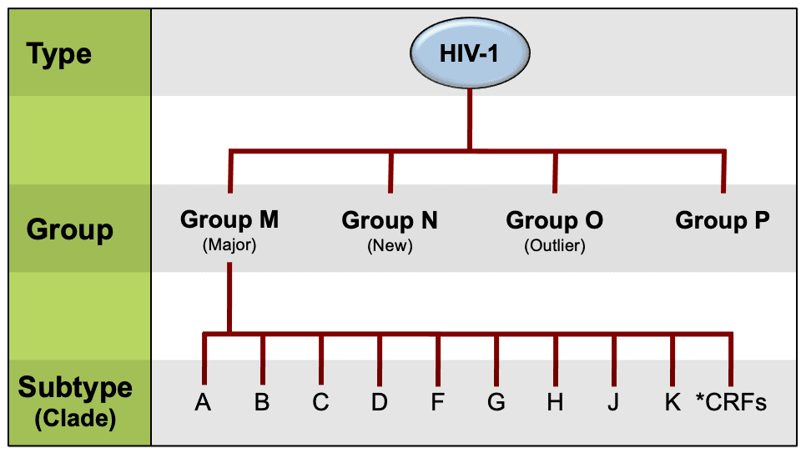
**circulating recombinant forms (CRFs)

Slide 15
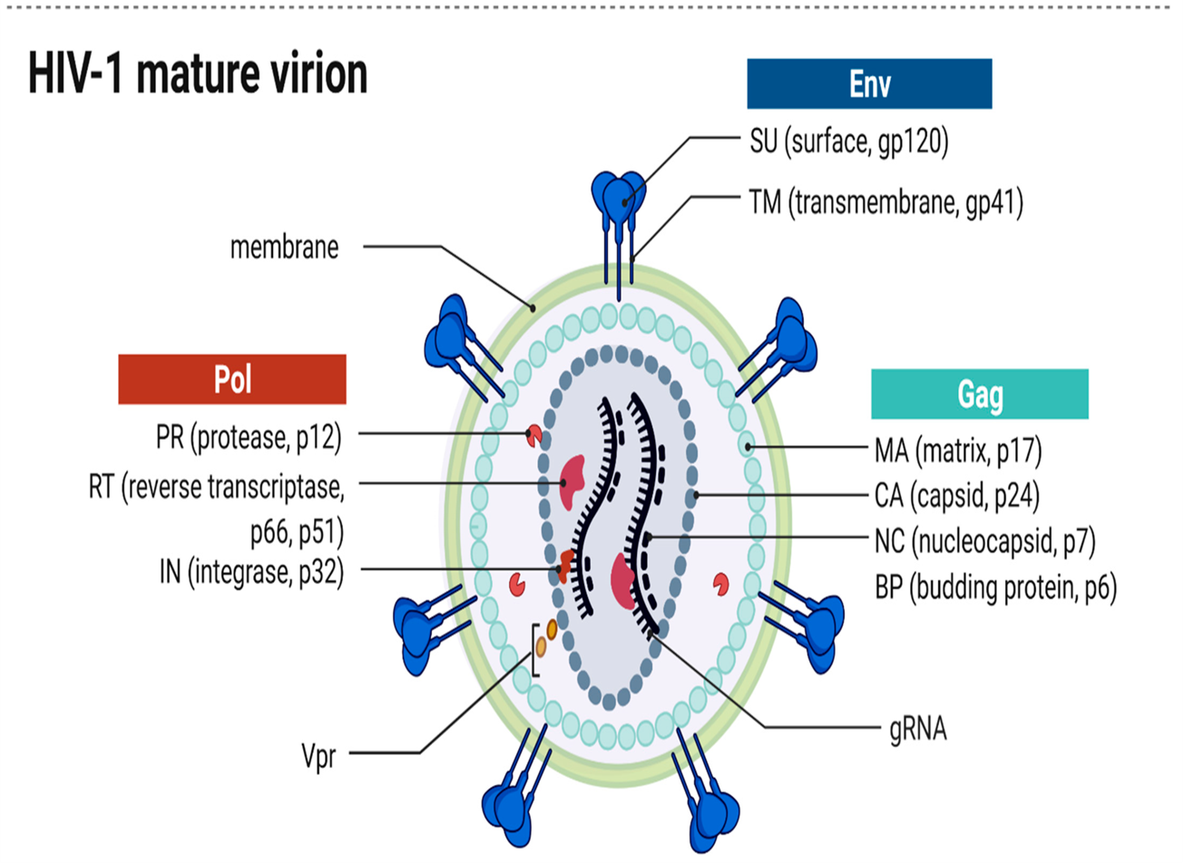
Viral structure:

Slide 16
HIV virulence
HIV’s virulence is driven by a small set of viral genes that encode structural proteins, enzymes, and accessory/regulatory factors that together enable entry, replication, immune evasion, and persistence.
key genes include gag, pol, env, tat, rev, nef, vif, vpr, and vpu, each with distinct functions that shape pathogenicity and treatment targets

Slide 17
Core structural and enzymatic genes
Gag- encodes the structural proteins (matrix p17, capsid p24, nucleocapsid) that form the virion core and are essential for particle assembly and maturation.
Pol- encodes the viral enzymes reverse transcriptase (RT), integrase (IN), and protease (PR); these are central to replication and are primary antiretroviral drug targets (RT inhibitors, integrase inhibitors, protease inhibitors).
Env- encodes the envelope glycoprotein precursor gp160, cleaved into gp120 (surface subunit) and gp41 (transmembrane fusion subunit); gp120 binds CD4 and CCR5/CXCR4, and the gp120/gp41 complex mediates entry and is a major target of neutralizing antibodies

Slide 18
Regulatory and accessory genes (virulence modulators)
tat: potent transactivator of viral transcription; increases viral RNA production and thus viral load and pathogenic potential.
rev: controls nuclear export of unspliced/partially spliced viral RNAs, enabling production of structural proteins and genomic RNA.
nef: multifunctional — downregulates CD4 and MHC‑I from the host cell surface, enhances infectivity, and modulates signaling to help immune evasion and persistence.
vif: counteracts the host restriction factor APOBEC3G (a cytidine deaminase) that would otherwise hypermutate viral cDNA; without Vif, infectivity drops markedly.
vpu: antagonizes tetherin/BST2, allowing release of budding virions from the cell surface; also contributes to CD4 degradation in the ER.
vpr: influences nuclear import of the preintegration complex and can induce G2 cell‑cycle arrest, which may favor viral replication in some cell types.

Slide 19
PATHOGENESIS
Viral life cycle steps that cause disease
Mechanisms of CD4+ T‑cell loss
Immune evasion strategies
How these produce clinical immunodeficiency.

Slide 20
Viral life cycle steps that cause disease
HIV enters the body (e.g. via mucosal lesions or via infection of mucosal/cutaneous immune cells)
HIV binds to CD4 and a co-receptor (CCR5 or CXCR4), fuses with the host cell, and releases its RNA.
Reverse transcriptase converts viral RNA into DNA, which is integrated into the host genome by integrase.
The host cell then transcribes and translates viral proteins.
New viral RNA and proteins assemble at the cell membrane, bud from the cell, and protease processes viral proteins to produce mature, infectious virions.

Slide 21
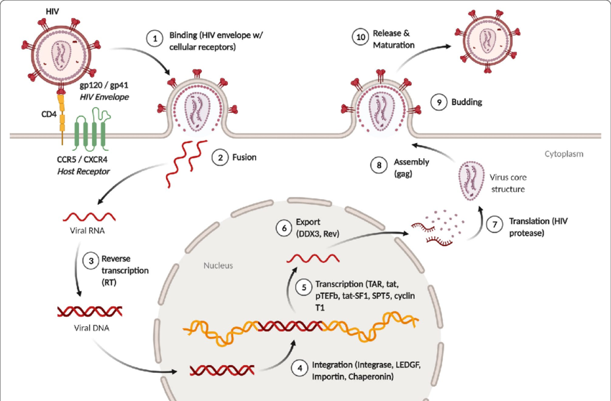

Slide 22
CD4⁺ T-cell depletion in HIV
HIV causes CD4⁺ T-cell loss through a combination of direct viral killing, immune-mediated destruction( CD8, NK cells), and bystander cell death (pyroptosis).
Ongoing viral replication drives chronic immune activation, leading to exhaustion and apoptosis of T cells.
HIV also damages lymphoid tissues (especially GALT) and impairs T-cell regeneration, resulting in a progressive decline of CD4⁺ T cells and immune failure

Slide 23
Immune evasion strategies
1. Envelope shielding and receptor masking. The HIV envelope glycoprotein (gp120/gp41) is heavily glycosylated and adopts conformations that hide conserved neutralizing epitopes, so antibodies have limited access to functionally important sites. This glycan shield and conformational masking reduce neutralization by antibodies and slow effective humoral responses.
2. High mutation rate and antigenic diversity. HIV’s error‑prone reverse transcriptase generates rapid sequence variation, producing quasi‑species within a single host. This antigenic drift enables escape from neutralizing antibodies and cytotoxic T‑cell recognition, and it fuels drug resistance when therapy is inconsistent.

Slide 24
3. Accessory proteins that disable host defenses. HIV encodes several small proteins that directly counteract innate and adaptive immune mechanisms: Vif neutralizes APOBEC3 cytidine deaminases that would hypermutate viral cDNA; Vpu antagonizes tetherin/BST2 to permit virion release; Nef downregulates MHC‑I and CD4 from the cell surface, reducing CTL(CD8) recognition and altering immune signaling. These actions blunt antigen presentation and innate restriction factors, increasing viral survival and spread.
4. Latency and the long‑lived reservoir. HIV establishes transcriptionally silent proviruses in resting memory CD4+ T cells and other cell types. These latent reservoirs are invisible to immune surveillance and unaffected by ART (i.e.CNS, Testes, lymphoid follicles), so stopping therapy leads to rapid rebound. Latency is the central barrier to sterilizing cure and a core immune‑evasion strategy.

Slide 25
Clinical Progression to AIDS
Threshold: When CD4+ count falls below ~200 cells/µL, opportunistic infections and cancers emerge.
Opportunistic infections: Pneumocystis pneumonia, tuberculosis, candidiasis, CMV, toxoplasmosis, cryptococcosis.
Malignancies: Kaposi’s sarcoma, non‑Hodgkin lymphoma, cervical cancer.
Systemic effects: Chronic inflammation contributes to cardiovascular disease, neurocognitive decline, and wasting.

Slide 26
HOST DEFENCE
The host defence system against HIV is multi‑layered, involving innate barriers, innate immune cells, and adaptive immunity. Despite these defences, HIV has evolved ways to evade or subvert them, which is why infection becomes chronic.
1. Physical and Chemical Barriers
Intact skin and mucosa: Prevent HIV entry; microtears or inflammation increase risk.
Mucosal secretions: Contain defensins, lactoferrin, and other antimicrobial peptides that can inhibit HIV.
Keratinocytes and epithelial cells: Release cytokines and chemokines that create an antiviral environment.

Slide 27
2 Innate Immune cells Defences
Langerhans cells (skin/mucosa): Capture HIV via langerin; can degrade virus in Birbeck granules.
Dendritic cells: Detect HIV via pattern recognition receptors (TLRs, lectins) and present antigens to T cells.
Macrophages: Phagocytose HIV, secrete cytokines, and act as antigen‑presenting cells (though they can also become reservoirs).
Natural Killer (NK) cells: Kill HIV‑infected cells and secrete IFN‑γ to enhance antiviral states.
Restriction factors:
  APOBEC3G: Induces lethal mutations in viral DNA.
  Tetherin (BST2): Prevents release of budding virions.
  SAMHD1: Restricts reverse transcription in myeloid cells.

Slide 28
3. Adaptive Immune Defences
CD8+ Cytotoxic T Lymphocytes (CTLs): Recognize HIV peptides presented on MHC‑I and kill infected cells.
CD4+ Helper T Cells: Coordinate immune responses (but are also HIV’s main target).
B cells: Produce neutralizing antibodies against gp120/gp41; some individuals develop broadly neutralizing antibodies (bnAbs) that target conserved regions of Env.
Memory responses: Adaptive immunity attempts to control viral load and establish long‑term surveillance.

Slide 29
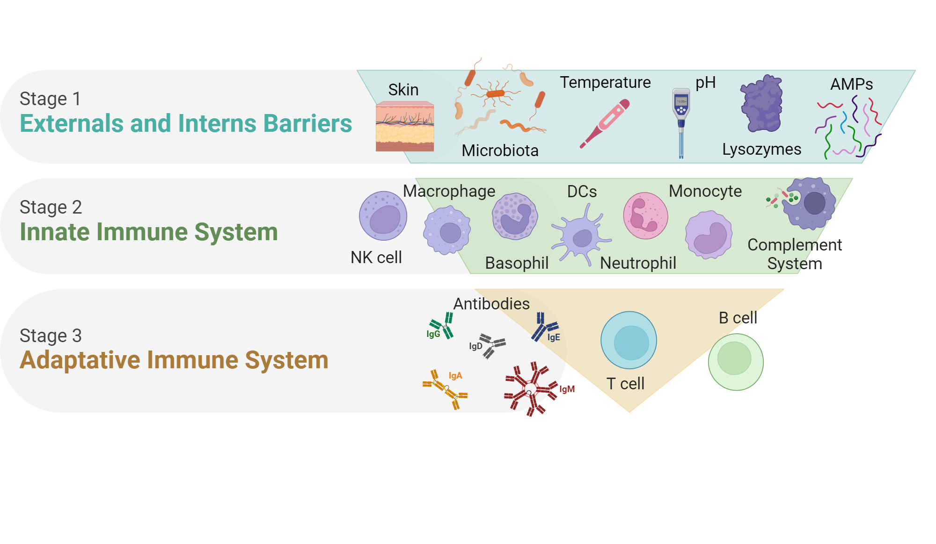

Slide 30
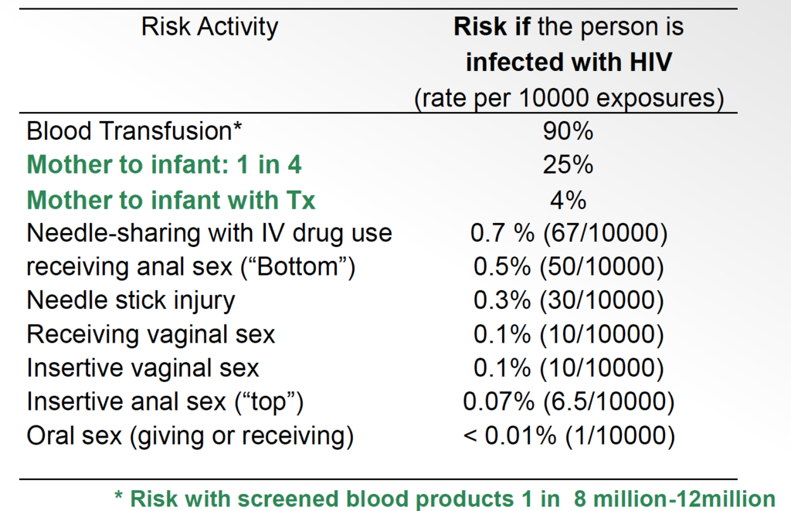
MODE OF TRANSMISSION OF HIV

Slide 31
Vulnerable groups
Adolescent girls and young women (AGYW)
Sex workers
People who inject drugs (PWID)
Prisoners
Men who have sex with men (MSM)
Transgender people
Infants born to HIV-positive mothers

Slide 32
NATURAL HISTORY OF HIV
1. Acute HIV Infection (Weeks 1–6)
Event: HIV enters via mucosal surfaces or blood and rapidly infects CD4+ T cells, macrophages, and dendritic cells.
Viremia: Viral load spikes dramatically; HIV disseminates to lymphoid tissues.
Immune response: CD8+ cytotoxic T cells and antibodies appear, lowering viral load but not eliminating the virus.
Clinical signs: Many experience acute retroviral syndrome (flu‑like illness: fever, rash, lymphadenopathy, sore throat).
Key feature: Massive depletion of CD4+ T cells in gut‑associated lymphoid tissue (GALT).

Slide 33
2. Clinical Latency / Chronic Infection (Years)
Event: Viral load stabilizes at a “set‑point” determined by host immunity and viral fitness.
Reservoirs: Latent infection established in resting memory CD4+ T cells.
Immune activity: Ongoing replication and immune activation continue silently.
Clinical signs: Often asymptomatic, but persistent generalized lymphadenopathy may occur.
Duration: Can last 5–10 years without treatment, shorter if viral set‑point is high.

Slide 34
3. Progressive Immunodeficiency
Event: Gradual decline in CD4+ T‑cell count due to direct killing, immune‑mediated destruction, and bystander pyroptosis.
Immune exhaustion: Chronic activation leads to dysfunction of T cells, B cells, and NK cells.
Clinical signs: Recurrent infections (oral candidiasis, herpes zoster, bacterial pneumonias), weight loss, chronic diarrhea.
Key marker: CD4+ count falls below 500 cells/µL, then progressively lower.

Slide 35
4. AIDS (Acquired Immunodeficiency Syndrome)
Definition: CD4+ count <200 cells/µL or presence of AIDS‑defining illnesses.
Opportunistic infections: Pneumocystis pneumonia, tuberculosis, cryptococcal meningitis, CMV, toxoplasmosis.
Malignancies: Kaposi’s sarcoma, non‑Hodgkin lymphoma, invasive cervical cancer.
Systemic effects: Wasting syndrome, neurocognitive decline, cardiovascular and renal complications.
Outcome without treatment: High mortality within 1–2 years after AIDS onset.

Slide 36
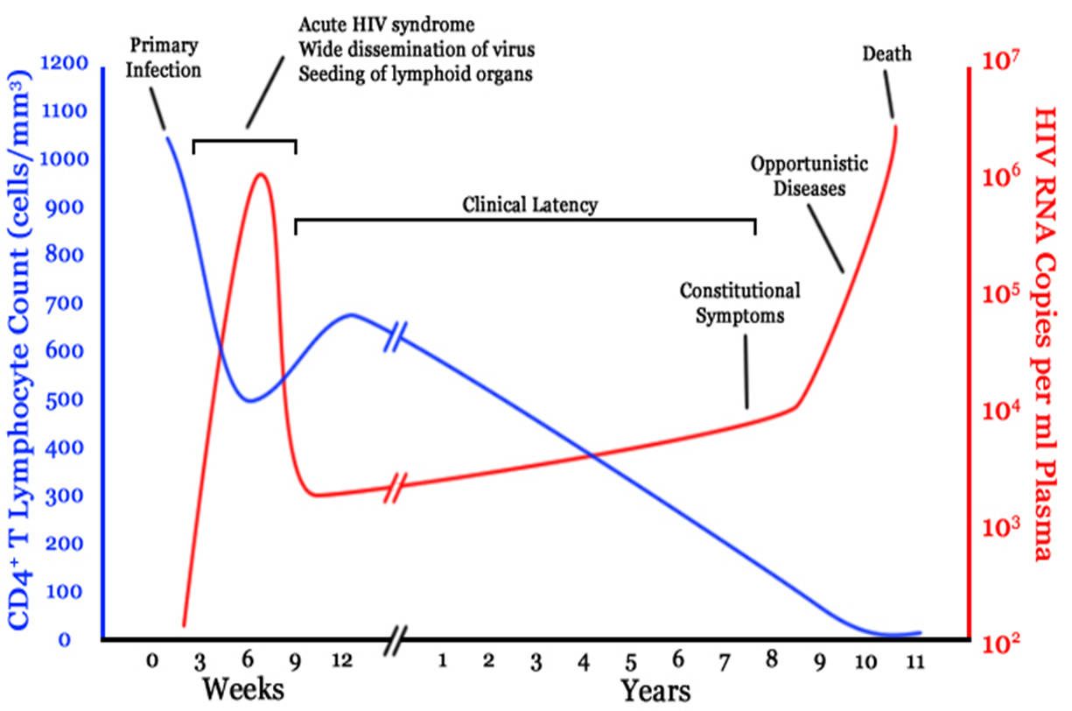

Slide 37
HIV PROGRESSORS
Based of the clinical picture, rate of CD4 loss and viral load HIV infected individuals tend to shown four different spectra of disease progression namely:
  Typical progressors 7-10yrs
  Rapid progressors <5ys
  Slow progressors > 10-15yrs
  Long-term non-progressors, Normal, stable CD4 <1%

Slide 38
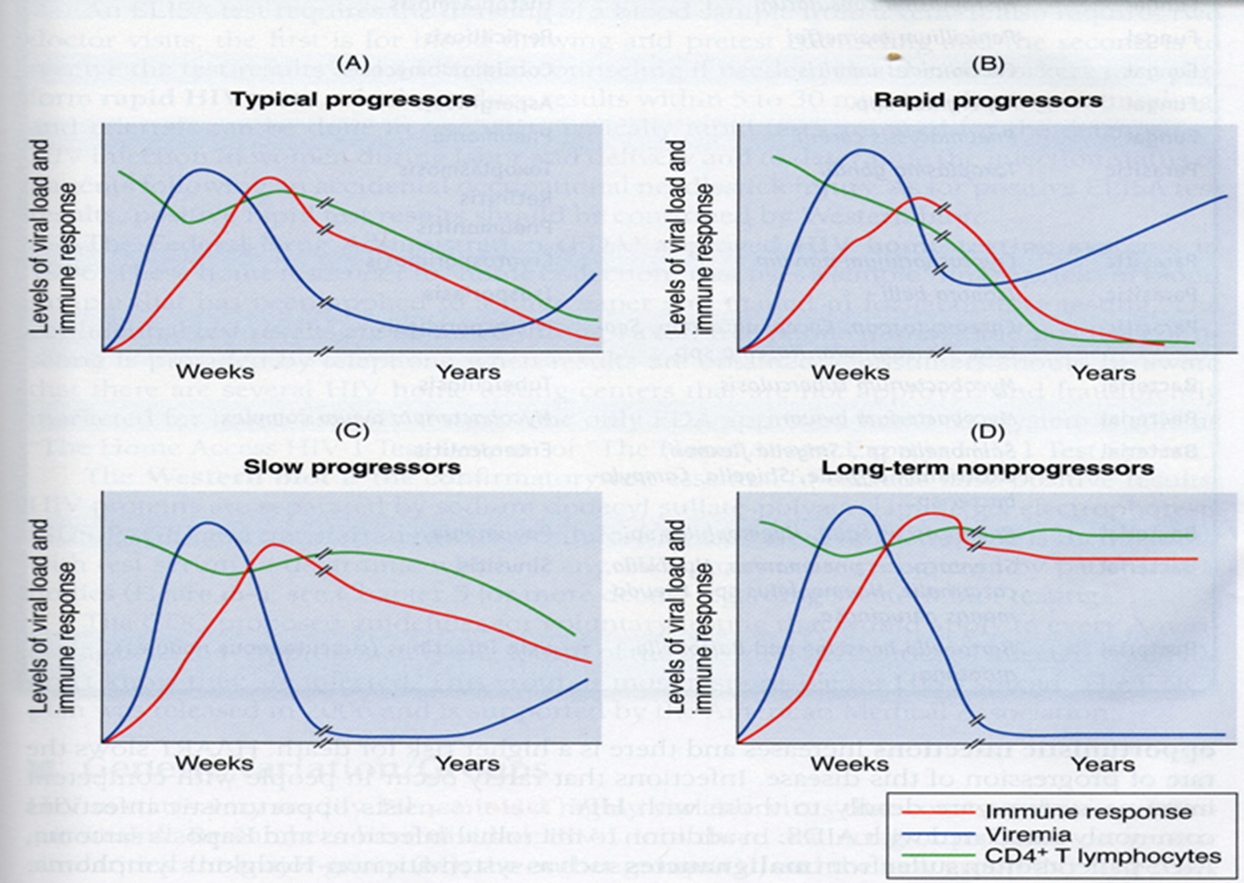
TYPES OF HIV PROGRESSORS

Slide 39
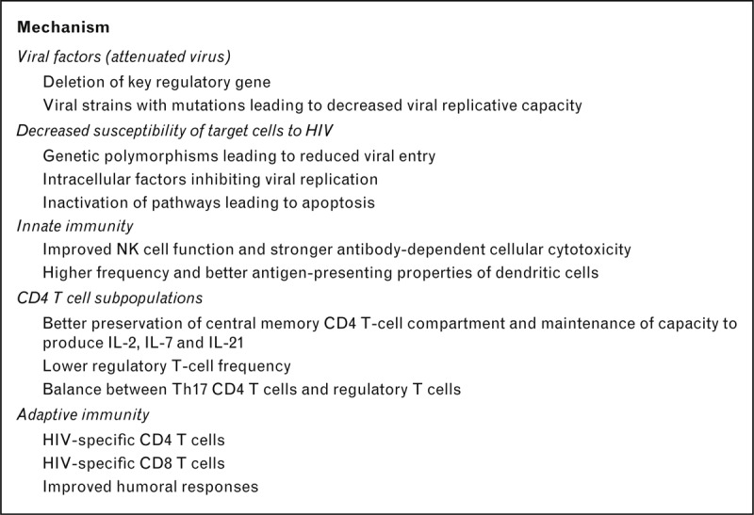
Potential mechanisms of viral suppression in HIV controllers

Slide 40
WHO HIV CLINICAL STAGING
Stage | CD4⁺ count (cells/µL) | Clinical features | Common opportunistic infections / conditions
Stage 1 (Acute HIV) | > 500 | Acute retroviral syndrome, lymphadenopathy | Generalized lymphadenopathy
Stage 2 (Early / Asymptomatic HIV) | 350–499 | Often asymptomatic, mild infections | Herpes zoster, recurrent URIs
Stage 3 (Symptomatic HIV) | 200–349 | Weight loss, chronic fever/diarrhea | Oral candidiasis, TB, oral hairy leukoplakia, bacterial pneumonia
Stage 4 (AIDS) | < 200 | Severe immunodeficiency | PCP (<200), Toxoplasma encephalitis (<100), Cryptococcal meningitis, CMV retinitis (<50), MAC, Kaposi sarcoma

Slide 41
COMPLICATIONS OF HIV
Opportunistic infections (OIs): As CD4 counts fall, patients are vulnerable to infections like PCP, TB, cryptococcal meningitis, toxoplasmosis, CMV, and chronic candidiasis.
Malignancies: HIV increases risk of cancers such as Kaposi’s sarcoma, non‑Hodgkin lymphoma, and invasive cervical cancer.
Neurologic issues: HIV can cause neurocognitive disorders, PML, and peripheral neuropathy.
Cardiovascular disease: Chronic inflammation and ART side effects accelerate atherosclerosis, cardiomyopathy, and pulmonary hypertension.
Renal disease: HIV‑associated nephropathy and chronic kidney disease are common, especially in African populations.

Slide 42
6) Hepatic disease: Coinfections with HBV/HCV and drug toxicity lead to liver complications.
7) Gastrointestinal problems: Chronic diarrhea, wasting syndrome, and parasitic infections occur in advanced disease.
8) Hematologic issues: Anemia, thrombocytopenia, and leukopenia result from HIV, OIs, or ART.
9) Dermatologic conditions: Seborrheic dermatitis, herpes zoster, and Kaposi’s sarcoma skin lesions often signal immune suppression

Slide 43
Guiding Principles for HIV Testing:
Include 3 C’s:
Confidentiality
Consent( informed)
Counseling( pre & post-test)

Slide 44
HIV diagnostics and monitoring
Initially, relied on centralised testing
Common tests used were: ELISA, Western blot (Confirmatory), PCR
Currently endorsing POCT and self-testing
Goal of HIV testing:
Identify infected individuals early
Initiate antiretroviral therapy (ART) to U=U
Prevent transmission
Notes:
The presence of HIV 1/2 infections in individuals can be ascertained only through the use of laboratory tests on body fluids such as blood, plasma, etc.
Common tests early approach were ELISA, Western blot ( Confirmatory test ) and PCR

Slide 45
HIV diagnosis strategies
Involve the detection of:
Viral components
Viral proteins ( p24, gp41, gp 120)
Viral nucleic acid ( RNA and proviral DNA)
Host immune response products: Abs
Depend on:
Age of patient
Stage of infection (early vs late)
Available laboratory technology

Slide 47
and window period
During the infection, the host may appear asymptomatic
Early diagnosis is the only mechanism to halt systemic damage and prevent secondary transmission
Notes:
The window period differs depending on the type of HIV diagnostic test used
The window period is the time between HIV infection and detectability by laboratory tests

Slide 48
Diagnosis during the acute infection phase
Test type | How it works | Sensitivity | Specificity | Window Period | Clinical Application
p24 Antigen Test | Detects p24 capsid protein of HIV virus before antibodies appear | Moderate–high | High | ~2 weeks | Early infection detection, mainly used as part of 4th generation tests
HIV RNA PCR (Viral Load Test) | Detects viral RNA through nucleic acid amplification (RT-PCR) | Extremely high | Extremely high | ~10–14 days | Early infection detection, treatment monitoring, ART response
HIV DNA PCR | Detects proviral HIV DNA integrated in host CD4 cells using PCR | Very high | Very high | ~2 weeks | Diagnosis of HIV in infants <18 months
4th Generation Ag/Ab ELISA | Detects p24 antigen + HIV antibodies simultaneously | Very high (>99%) | Very high (>99%) | ~18 days | Early diagnosis of acute HIV infection, hospital laboratory screening
Notes:
HIV proviral DNA gold standard for infants

Slide 49
Diagnosis during the established infection phase
Test type | Mmechanism | Sensitivity | Specificity | Window Period | Clinical Application
Rapid Antibody Tests | Detect IgG antibodies against HIV-1/2 using immunochromatographic lateral flow assays | Very high (>99% after window period) | Very high (>99%) | ~3–12 weeks | Routine HIV screening, community testing, VCT clinics, antenatal clinics
3rd Generation ELISA | Detects IgG and IgM antibodies against HIV using enzyme-linked immunosorbent assay | Higher sensitivity than rapid tests | Very high | ~3–4 weeks | Laboratory confirmation and blood donor screening

Slide 50
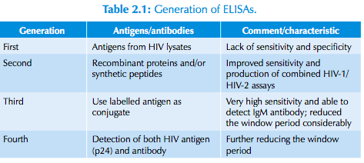
LABORATORY DIAGNOSIS

Slide 51
National HIV testing algorithm for the general population
Initial Test: Start with the SD Bioline
2. If positive: perform second test: first response HIV 1- 2
3. If reactive confirmation with Unigold rapid test
Final Results:
  If Unigold is positive (+), the HIV diagnosis is confirmed
  If Unigold is negative (-), the result is inconclusive and must be further confirmed using an ELISA test
Notes:
Due to low prevalence of HIV, it is currently recommended that three rapid reactive tests are required to report a positive

Slide 52
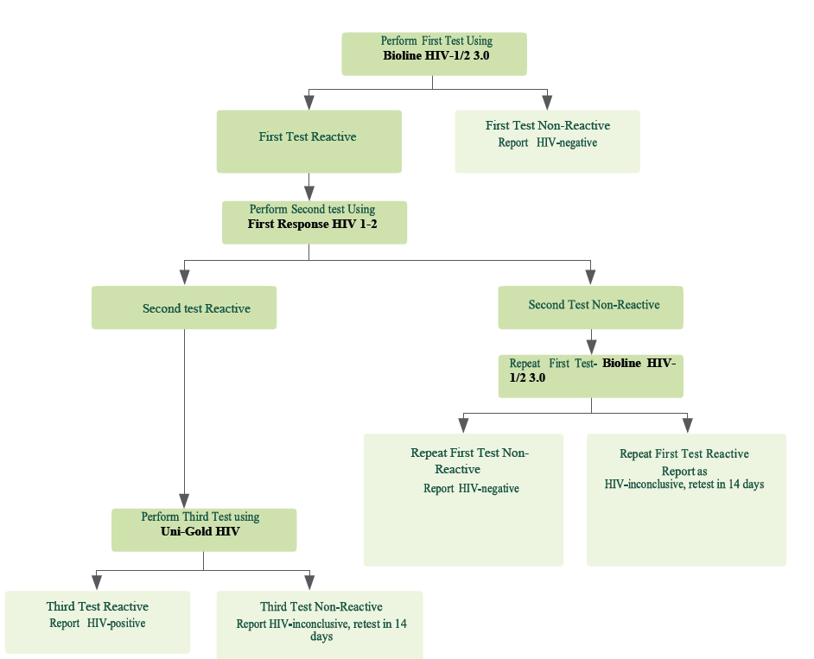

Slide 53
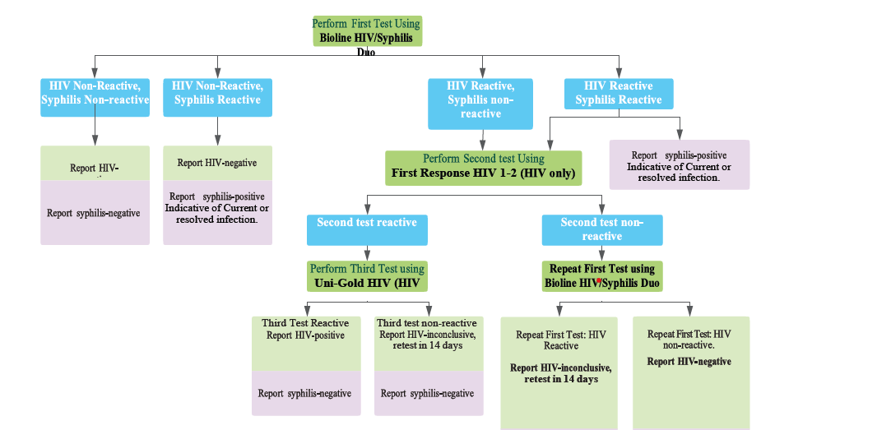
National HIV testing algorithm for ANC clients
Notes:
Dual test of syphilis and HIV is recommended in pregnant women

Slide 54
National HIV testing algorithm in infants below 18 months
Less than 6 wks:
Recommended test: HIV DNA PCR
Detects viral genetic material directly from blood (DBS or whole blood)
6 to 18 months
Recommended test HIV DNA PCR
Can repeat at different intervals to confirm infection
After 18 months
Recommended test: Rapid Ab test or ELISA
Maternal Abs worn out, Abs test reliable
Maternal IgG antibodies cross the placenta and can persist in the infant for up to 18 months
Standard antibody tests cannot distinguish maternal antibodies vs the baby’s own antibodies
Therefore, virological tests are required to detect the virus itself in infants
Notes:
PCR tests detect viral DNA (proviral DNA) or RNA, not antibodies
Early Infant Diagnosis (EID) is critical to initiate ART early, which reduces morbidity and mortality

Slide 55
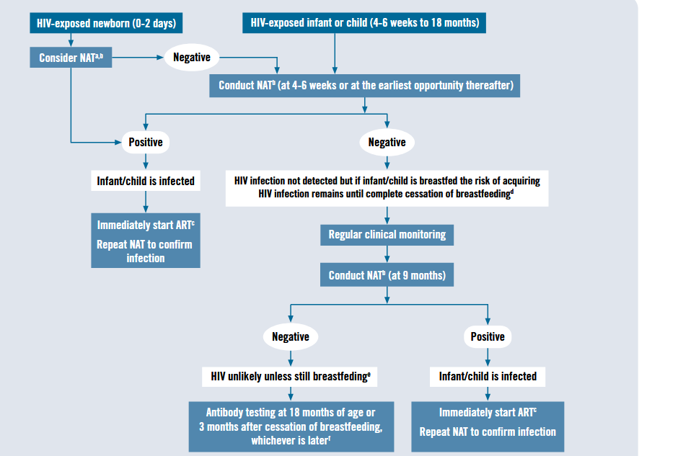
Notes:
WHO guideline

Slide 56
Tanzania Algorithm
Do HIV DNA-PCR at birth to all exposed babies;
  if positive, take another sample immediately for DNA PCR confirmatory test
  Initiate the child on ART
Children with negative results for HIV should have DNA-PCR
  test at 6 weeks, 9 months of age
Another test should be performed
  At 12 weeks after cessation of breastfeeding using an antibody test
  At 18 months of age, a final rapid antibody test should be done
  Any results for a child below 18 months of age should be confirmed by DNA-PCR test and initiated on ART if found positive
Notes:
For a child who has completely stopped breastfeeding for more
than 12 weeks before undergoing DNA PCR testing, a negative
DNA PCR test excludes HIV infection

Slide 57
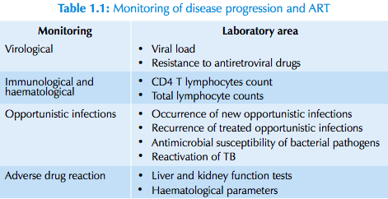
HIV MONITORING

Slide 58
BASELINE INVESTIGATIONS AFTER DIAGNOSIS OF HIV
Before starting antiretroviral therapy (ART), a structured set of investigations is recommended to establish baseline health, detect co‑infections, and guide safe treatment. Here’s a summary hierarchy:
1) Baseline HIV‑specific tests
Confirm HIV diagnosis (two different tests, or PCR if infant).
CD4+ T‑cell count → assesses immune status and risk of opportunistic infections.
HIV viral load (RNA copies/ml) → baseline for monitoring ART response.
HIV drug resistance testing (if available) → guides regimen choice.

Slide 59
2) Screening for Co‑infections
Tuberculosis (TB): Symptom screen, chest X‑ray, sputum GeneXpert, TB-LAM.
Hepatitis B and C: HBsAg, anti‑HCV antibody.
Syphilis and other STIs: VDRL/RPR, clinical exam.
Opportunistic infections: CD4 <200, Cryptococcal antigen (if CD4 <200), toxoplasma IgG.

Slide 60
3) General Health and Safety Labs
Full blood count (FBC): Detects anemia, leukopenia, thrombocytopenia.
Renal function: Creatinine, eGFR → important for tenofovir use.
Liver function tests (LFTs): ALT, AST, bilirubin → monitor hepatotoxicity.
Blood glucose & lipids: Baseline metabolic profile (especially if protease inhibitors and integrase inhibitors use planned).
Pregnancy test (in women of childbearing age): Guides regimen choice.

Slide 61
Additional/Contextual Investigations
HLA‑B5701 testing:* If abacavir considered (risk of hypersensitivity).
G6PD deficiency screen: If dapsone prophylaxis planned.
Nutritional assessment: Weight, BMI, baseline for monitoring

Slide 62
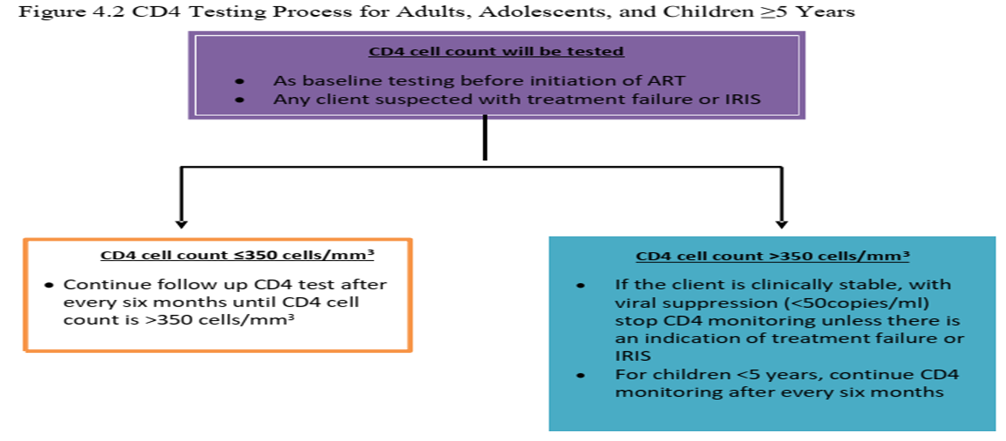
CD4 ALGORITHM

Slide 63
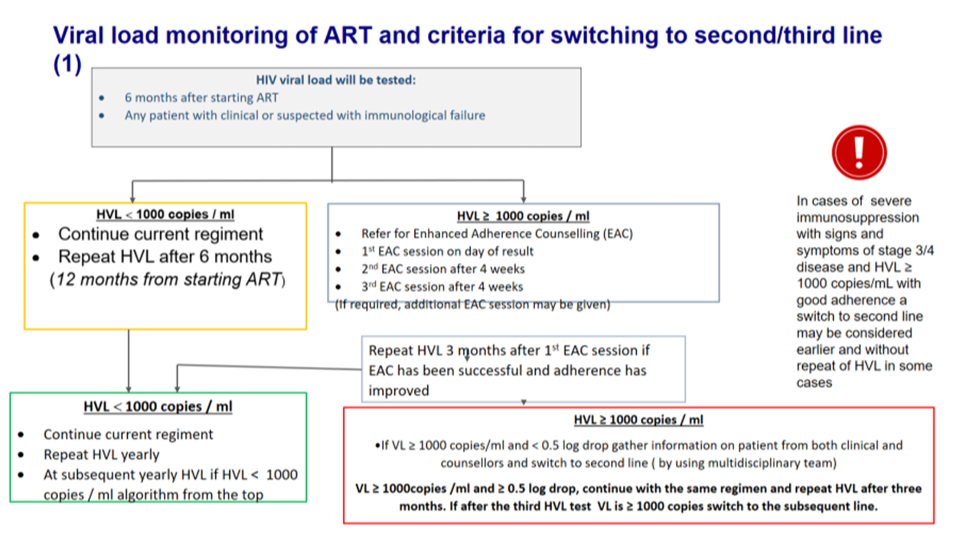
VIRAL LOAD ALGORITHM

Slide 64
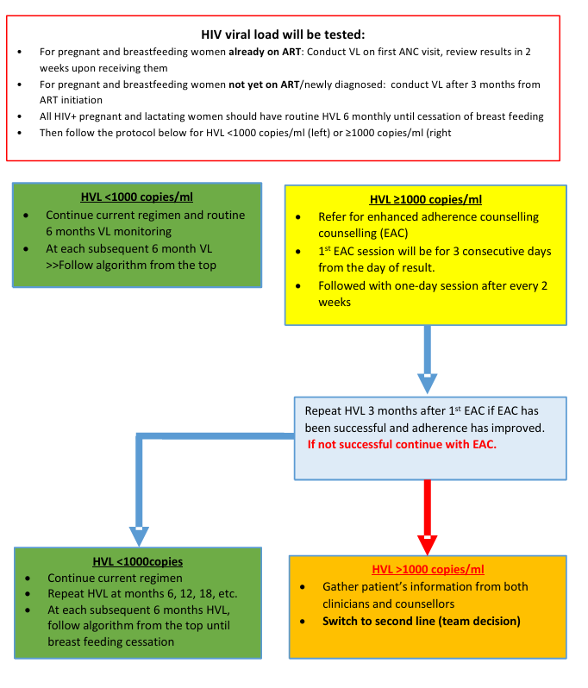
HVL Monitoring Algorithm for Pregnant and Breastfeeding Mothers

Slide 65
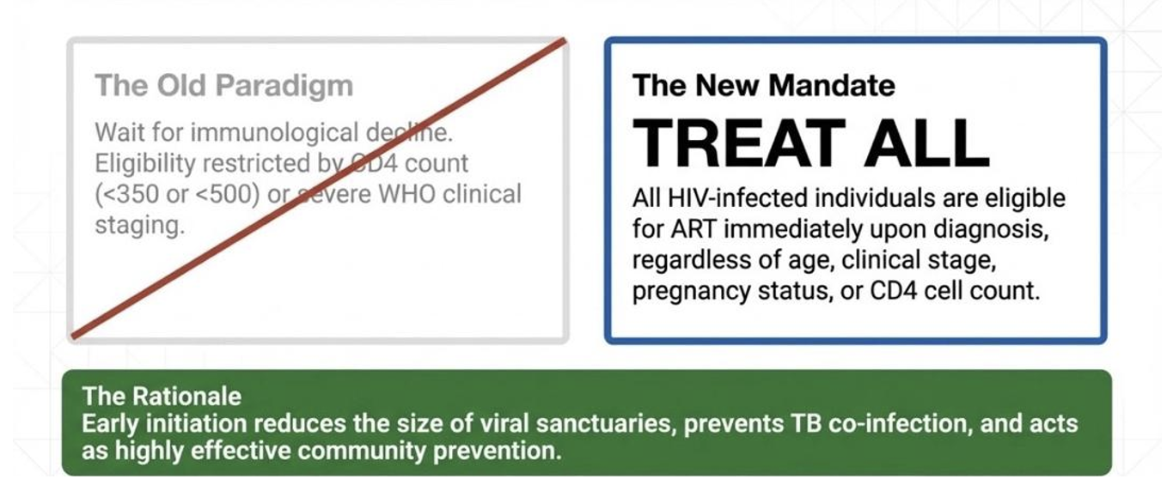
HIV treatment: Paradigm shift

Slide 66
TREATMENT OF HIV
Primary Goals:
Maximal and durable viral suppression (<50 copies/ml).
Restoration/preservation of immune function (CD4 recovery ≥500 cells/mm³).
Reduction of HIV‑related morbidity and mortality → improved survival and quality of life.

Slide 67
Secondary Goals:
Reduce the number of unsuppressed individuals, lowering community transmission.
Prevent mother‑to‑child transmission in pregnant and lactating women.
Reduce transmission in discordant couples (one partner HIV‑positive, the other negative).
👉 ART aims to suppress HIV, restore immunity, improve survival, and reduce transmission — but must be lifelong due to viral reservoirs.

Slide 68
ART’s CLASSES
Drug Class | Abbreviation | Mechanism of Action | Examples (as per guidelines)
Nucleotide Reverse Transcriptase Inhibitors | NtRTIs | Nucleotide analogues that inhibit the HIV reverse transcriptase enzyme, preventing viral DNA synthesis | Tenofovir disoproxil fumarate (TDF), Tenofovir alafenamide (TAF)
Nucleoside Reverse Transcriptase Inhibitors | NRTIs | Inhibit viral RNA-dependent DNA polymerase (reverse transcriptase); backbone of ART regimens | Zidovudine (AZT), Lamivudine (3TC), Emtricitabine (FTC), Abacavir (ABC)
Non-Nucleoside Reverse Transcriptase Inhibitors | NNRTIs | Bind directly to reverse transcriptase enzyme and block viral RNA to DNA transcription (not incorporated into DNA) | 1st gen: Nevirapine (NVP), Efavirenz (EFV) 2nd gen: Etravirine (ETR)

Slide 69
Drug Class | Abbreviation | Mechanism of Action | Examples (as per guidelines)
Protease Inhibitors | PIs | Inhibit HIV protease enzyme, preventing maturation of infectious virions; usually boosted with ritonavir | 1st gen: Atazanavir (ATV), Lopinavir (LPV), Ritonavir (RTV – booster) 2nd gen: Darunavir (DRV)
Integrase Strand Transfer Inhibitors | INSTIs | Inhibit integrase enzyme, preventing integration of viral DNA into host cell genome | Dolutegravir (DTG), Raltegravir (RAL)
Fusion Inhibitors | — | Prevent fusion of HIV with host cell membrane | Enfuvirtide (ENF)
CCR5 (Chemokine Receptor) Inhibitors | — | Block CCR5 co-receptor, preventing HIV entry into host cells | Maraviroc

Slide 70
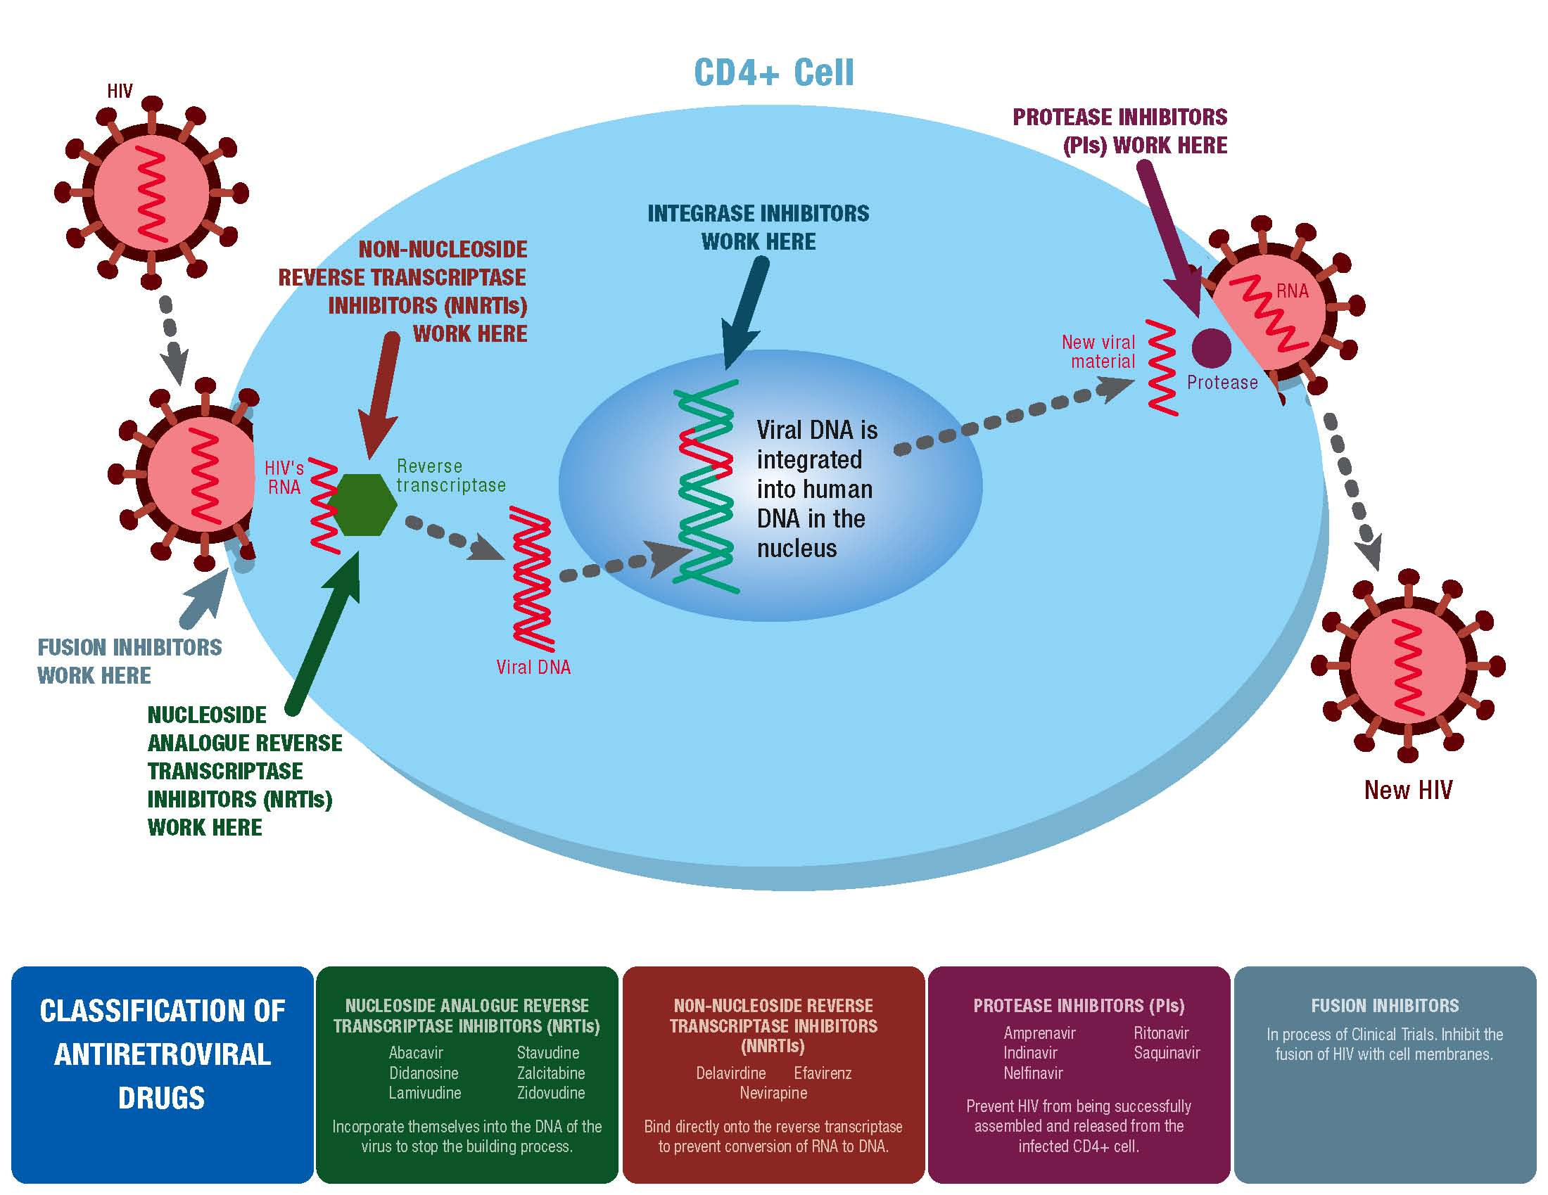
Where ARVs Work in HIV Lifecycle

Slide 71
When to start ART?
Most major international and local guidelines now strongly recommend rapid initiation of Antiretroviral Therapy (ART)
Which is defined as starting treatment within 7 days of diagnosis, and ideally on the same day.
Studies have demonstrated overall benefit in early initiation of ART vs deferred ART initiation ¹
While no major guideline "rejects" rapid initiation as a general policy
They all mandate a delay in the presence of certain opportunistic infections (OIs) to prevent Immune Reconstitution Inflammatory Syndrome (IRIS)
1. INSIGHT START Study Group, Lundgren JD, Babiker AG, et al. Initiation of Antiretroviral Therapy in Early Asymptomatic HIV Infection. N Engl J Med. 2015;373(9):795-807. doi:10.1056/NEJMoa1506816
Notes:
ART initiation should be offered on the same day to people who are ready to start
People should be encouraged but not coerced to start ART immediately and should be supported in making an informed choice regarding when to start ART and what ARV drug regimen to use

Slide 72
What ART to start?
Preferred Regimen: DTG + 2 NRTls remains the preferred first-line ART globally. ^{1, 2}
Efficacy: Superior viral suppression compared to EFV-based regimens.²
Genetic Barrier: High barrier to resistance minimizes failure risks.
Tolerability: Reduced CNS side effects compared to older NNRTI options.²
Suitable across adults, children (3kg+), and pregnant women.
TB Context: Requires twice-daily dosing when used with rifampicin.
ADVANCE study. Venter WDF, Moorhouse M, Sokhela S, et al. Dolutegravir plus Two Different Prodrugs of Tenofovir to Treat HIV. N Engl J Med. 2019;381(9):803-815. doi:10.1056/NEJMoa1902824
SINGLE study. Walmsley SL, Antela A, Clumeck N, et al. Dolutegravir plus abacavir-lamivudine for the treatment of HIV-1 infection. N Engl J Med. 2013;369(19):1807-1818. doi:10.1056/NEJMoa1215541

Slide 73
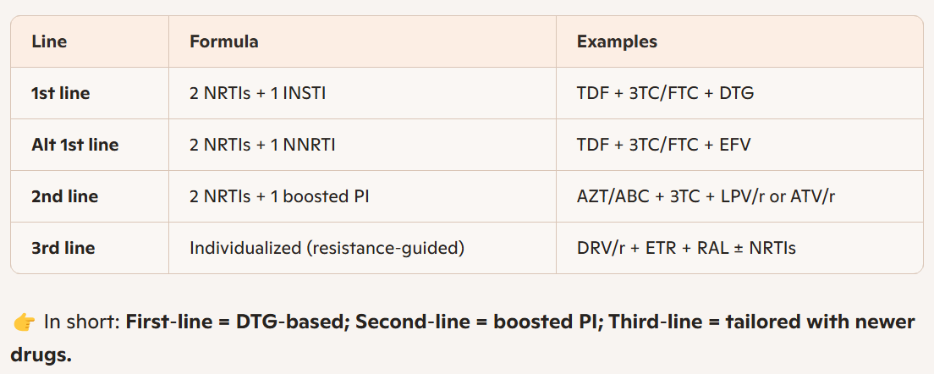
Table of standard ART combination

Slide 74
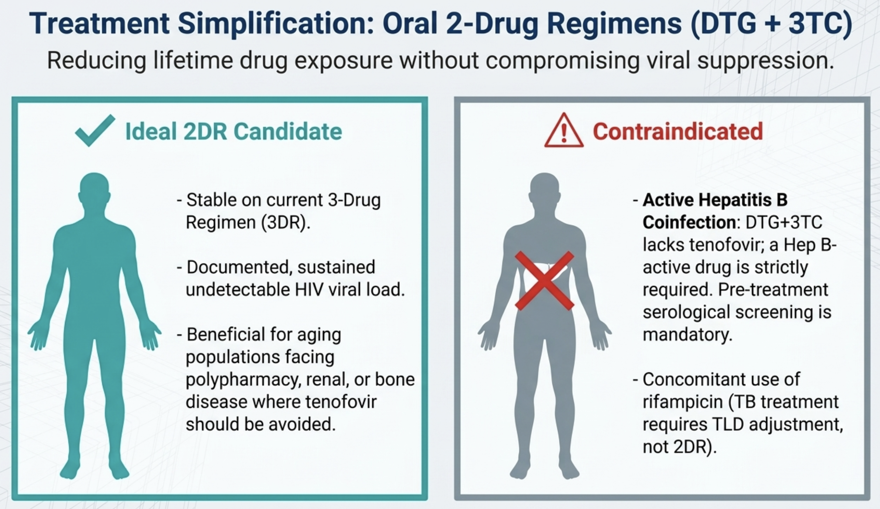
New Frontiers
Cahn P, Madero JS, Arribas JR, et al. Dolutegravir plus lamivudine versus dolutegravir plus tenofovir disoproxil fumarate and emtricitabine in antiretroviral-naive adults with HIV-1 infection (GEMINI-1 and GEMINI-2): week 48 results from two multicenter, double-blind, randomized, non-inferiority, phase 3 trials. Lancet. 2019;393(10167):143-155. doi:10.1016/S0140-6736(18)32462-0
Osiyemi O, De Wit S, Ajana F, et al. Efficacy and Safety of Switching to Dolutegravir/Lamivudine Versus Continuing a Tenofovir Alafenamide-Based 3- or 4-Drug Regimen for Maintenance of Virologic Suppression in Adults Living With Human Immunodeficiency Virus Type 1: Results Through Week 144 From the Phase 3, Noninferiority TANGO Randomized Trial. Clin Infect Dis. 2022;75(6):975-986. doi:10.1093/cid/ciac036

Slide 75
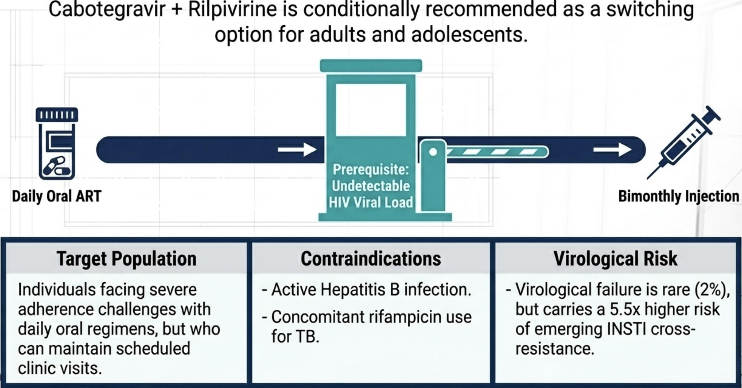
Long-Acting Injectables(LAI)
Regimen: Cabotegravir(INSTI) + Rilpivirine(NNRTI) injected IM every 2 months.
Indication: For stable suppressed patients who face “pill fatigue” or stigma
Orkin C, Arasteh K, Górgolas Hernández-Mora M, et al. Long-Acting Cabotegravir and Rilpivirine after Oral Induction for HIV-1 Infection. N Engl J Med. 2020;382(12):1124-1135. doi:10.1056/NEJMoa1909512

Slide 76
Changing Antiretroviral Therapy
There are multiple reasons that may prompt the need to change antiretroviral therapy.
These can be grouped into two major categories:
Treatment failure
Drug specific adverse events (toxicity)
When changing treatment, the following should be observed:
If changing due to treatment failure, change should be personalized
If changing due to toxicity, Change only the drug suspected to be causing the problem.

Slide 77
TREATMENT FAILURE AND RESISTANCE
Treatment failure: Is a failure to achieve or maintain viral suppression after ≥ 6month of ART
3 Types:
Virological failure
Immunological failure
Clinical failure

Slide 78
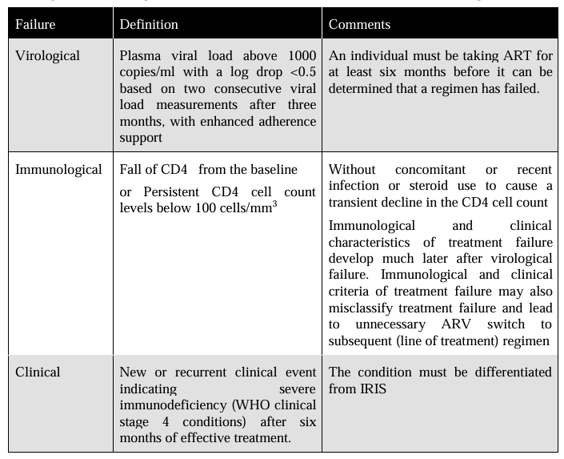

Slide 79
Causes of treatment failure include:
  Drug resistance.
  Lack of adherence.
  Drug-drug interactions.
Notes:
4. Clinical Conditions Affecting Absorption
Conditions like diarrhoeal illness, gastrointestinal malabsorption, or opportunistic infections (e.g., cryptosporidiosis) can reduce drug uptake.
These are managed clinically — treat the underlying cause, ensure nutritional support, and adjust ART if needed.

Slide 80
  1. DRUG RESISTANCE
Definition
HIV drug resistance is the ability of HIV to replicate despite the presence of antiretroviral drugs, due to viral genetic mutations that reduce drug effectiveness.
Types of HIV Drug Resistance
1. Primary (Transmitted) resistance
Occurs when a person is infected with an already drug-resistant HIV strain
Seen in ART-naïve individuals
2. Secondary (Acquired) resistance
Develops after ART initiation
Most common form in Tanzania
Usually due to poor adherence or treatment interruptions

Slide 81
2. Patterns in Tanzania
NNRTI resistance is most common (especially to Efavirenz and Nevirapine).
NRTI resistance (AZT, 3TC, TDF) emerges with poor adherence or prolonged exposure.
PI resistance is less frequent due to high genetic barrier, but can occur with poor adherence to boosted PI regimens.
INSTI resistance (Dolutegravir, Raltegravir) is rare but possible if adherence is poor

Slide 82
Factors Leading to Resistance
Poor adherence (missed doses, treatment interruptions).
Drug stock‑outs or supply interruptions in health facilities.
Use of suboptimal regimens (e.g., mono‑therapy, outdated NNRTI‑based regimens).
Delayed switching after virologic failure.
High baseline viral load before ART initiation.
Co‑infections (TB, HBV, HCV) complicating treatment.
Drug interactions reducing ARV levels.
Pregnancy and breastfeeding interruptions if ART is not maintained.
Pediatric challenges (liquid formulations, dosing errors).

Slide 83
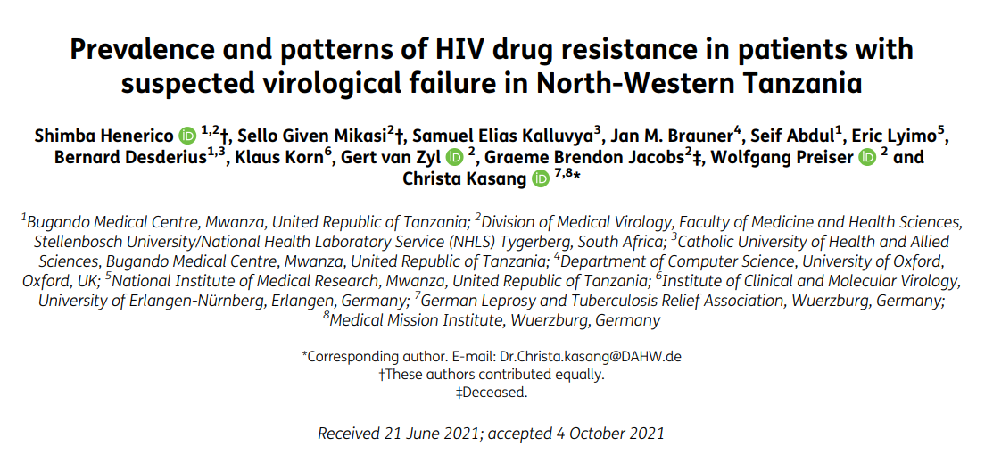

Slide 84
HIV Drug Resistance in Suspected Virological Failure – North-Western Tanzania
Study Design
• Cross-sectional study (2013–2017), 326 patients
• Suspected failure: single viral load >1000 copies/mL
• Genotyping of protease & RT regions
Key Findings
• 20.2% had suspected virological failure
• 85.7% of genotyped patients had ≥1 major resistance mutation
• Common mutations: M184V (75%), T215Y (41%), K103N (39%), G190A (29%)
• High-level resistance to NRTIs & NNRTIs; no PI resistance detected
• Subtypes: A1 (36%), C (34%), D (27%)
Conclusion / Message
• A single high viral load >1000 copies/mL strongly predicts resistance mutations.
• Suggests earlier switching to second-line regimens could prevent delays and improve outcomes.

Slide 85
ART SWITCHING & NRTI RECYCLING
GUIDING PRINCIPLES FOR SWITCHING
Virological Failure
  Definition: Two consecutive viral load (VL) measurements ≥ 1000 copies/mL after 3 months of enhanced adherence counseling (EAC).
The "Recycling" Strategy
  WHO 2026 maintains that NRTIs (TDF or ABC) can be "recycled" in second-line regimens when switching from an NNRTI-based first-line to a DTG-based or PI-based second-line. ¹
Integrase-Inhibitor (INSTI) Exception
  If failing a 1st-line DTG regimen, switching requires a resistance-guided choice, usually a Protease Inhibitor (DRV/r) with a new NRTI backbone (e.g., AZT).
1. The NADIA Trial: Demonstrated that Tenofovir (TDF) maintains efficacy in 2nd-line regimens even in the presence of predicted M184V/V resistance mutations.
Paton et al., NEJM 2021 (NADIA)

Slide 86
2. LACK OF ADHERENCE
Adherence means sticking firmly to treatment regimen by taking the right medicine, with the right dose, at the right time, in the right frequency, in the right way every day and exactly as agreed between healthcare providers, clients and care givers.
Category | Key Causes of Poor Adherence
Social | Stigma & discrimination; lack of support; non‑disclosure; peer pressure
Economic | Poverty; transport cost; food insecurity; competing financial priorities
Behavioral | Alcohol/substance use; forgetfulness; low ART knowledge; depression; feeling well; side effects; use of traditional medicines

Slide 87
Stigma + poverty + lack of support are the biggest social and economic drivers.
Behavioral factors like substance use and knowledge gaps critically reduce daily adherence.
Interventions must target community, economic support, and counseling to improve outcomes.
Adherence level of >95% is needed to maximize the benefits of ART. However, achieving such high rates over a long period of time is a challenge. Therefore, to improve adherence, different approaches should be sought and tailored to the patient’s lifestyle through proper counselling and health education.
Notes:
ApproachDescription
Health education
Reminder tools Use alarms, SMS reminders, pillboxes, or smartphone apps to support daily adherence.
Peer support / treatment buddies Engage experienced patients or peers to provide guidance, encouragement, and accountability
Side effect management Educate patients on expected side effects and provide symptomatic treatment to minimize discontinuation
Mental health support Screen and treat depression, anxiety, or substance use that may interfere with adherence.
Flexible clinic services Offer convenient appointment schedules, fast-track refills, or community ART delivery to reduce missed doses.
Social support interventions Encourage disclosure to trusted family/friends, reduce stigma, and strengthen support networks.
Economic support Provide transport assistance, nutritional support, or linkage to social services if financial barriers exist.
Integration with routine care Combine ART services with other health services to reduce clinic visits and improve continuity

Slide 88
3. DRUG-DRUG INTERACTIONS
ART drugs can interact with other medications, affecting absorption, metabolism, and efficacy, potentially leading to treatment failure or toxicity.
Always review all meds and supplements before starting ART
ART Class | Common Interactions | Effect
NNRTIs (e.g., efavirenz, nevirapine) | Rifampicin (TB treatment), anticonvulsants | Can reduce NNRTI levels → risk of treatment failure
PIs (e.g., lopinavir/ritonavir) | Rifampicin, statins, some antifungals | May increase or decrease PI levels; careful dose adjustment needed
Integrase Inhibitors (e.g., dolutegravir) | Rifampicin, polyvalent cations (Ca, Mg, Al) | Reduced absorption; separate from cations by ≥2 hrs
NRTIs (e.g., tenofovir, lamivudine) | Some nephrotoxic drugs | Increased risk of renal toxicity

Slide 89
Drug specific adverse events (toxicity)
ARV | Major toxicities | Risk factors | Suggested management
TDF | • Renal tubular dysfunction / Fanconi syndrome • ↓ Bone mineral density • Lactic acidosis, hepatic steatosis • Hepatitis B flare on stopping | • Renal disease • Older age • BMI <18.5 / weight <50 kg • Diabetes, hypertension • Nephrotoxic drugs / boosted PI • Osteoporosis risk | • If 1st line → switch to ABC • If 2nd line → switch to AZT or ABC • Avoid abrupt stop in HBV
ABC | • Hypersensitivity reaction | • HLA-B*5701 positive | • Stop permanently • Substitute with TDF or AZT
AZT | • Anaemia, neutropaenia • Myopathy • Lipoatrophy / lipodystrophy • Lactic acidosis | • Baseline anaemia • CD4 ≤200 cells/mm³ • BMI >25 • Prolonged NRTI use | • Substitute with ABC

Slide 90
ARV | Major toxicities | Risk factors | Suggested management
EFV | • CNS toxicity (dizziness, insomnia, abnormal dreams) • Psychiatric symptoms • Seizures • Hepatotoxicity • Severe rash / hypersensitivity • Gynaecomastia | • Mental illness • Daytime dosing • Seizure disorder • Liver disease / HBV / HCV | • Dose at bedtime • Reduce to EFV 400 mg or switch to DTG • Severe → switch class
NVP | • Hepatotoxicity • Severe skin rash / SJS • Hypersensitivity | • Liver disease • HBV / HCV • Hepatotoxic drugs • High CD4 (>250 women, >400 men) | • Mild → switch to EFV • Severe / <3 yrs → switch to INSTI or PI
LPV/r | • Hepatotoxicity • Pancreatitis • Dyslipidaemia / metabolic syndrome • Lipoatrophy • Severe diarrhea, prematurity | • Liver disease • HBV / HCV • Advanced HIV | • Replace with ATV/r
ATV/r | • Indirect hyperbilirubinaemia (jaundice) • Nephrolithiasis • Prematurity | • Liver disease • HBV / HCV | • Usually continue • Severe jaundice + ↑ transaminases → switch to LPV/r

Slide 91
ARV | Major toxicities | Risk factors | Suggested management
DTG | • ↑ Cholesterol • Mild ↑ liver enzymes • ↑ Creatinine • Insomnia, headache | • Dyslipidaemia • Diabetes • Hypertension | • Monitor lipids & LFTs • Symptomatic treatment
ETR | • Rash, nausea • ↑ Lipids • GI upset, fatigue • Rare: severe rash, neuropathy, renal failure | • None known | • Monitor severity • Symptomatic treatment
RAL | • ↑ Cholesterol, glucose, AST, bilirubin • Rash, fatigue, dizziness, insomnia | • Dyslipidaemia • Diabetes • Hypertension | • Severe toxicity → switch to DTG (>12 yrs)
DRV/r | • ↑ Cholesterol & triglycerides • Diarrhea, headache, rash, nausea | • Dyslipidaemia | • Monitor • Symptomatic treatment

Slide 92
Memorizing ART’s Toxicity
TDF → kidney & bone
ABC → hypersensitivity
AZT → anaemia
EFV → CNS
NVP → liver & skin
PI → metabolic
DTG → lipids & creatinine

Slide 93
Immune Reconstitution Inflammatory Syndrome (IRIS)
Definition:
IRIS is the worsening or unmasking of opportunistic infections (OIs), malignancies, or autoimmune conditions after starting ART due to immune system recovery.
Who is at Risk?
Treatment-naïve patients
Advanced HIV (CD4 <50 cells/mm³)
Undiagnosed/untreated OIs or malignancies
ART started before or shortly after OI treatment
Rapid viral suppression (e.g., with Dolutegravir)

Slide 94
Common Features:
Fever, LN enlargement, Worsening pulmonary or CNS lesions, New or worsening uveitis/retinitis
May unmask hepatitis B/C infections
Diagnosis:
Major criteria:
  Typical OI/malignancy presentation during ART response (inflammation, lesion enlargement, organ dysfunction)
  Drop in HIV viral load >1 log₁₀ (if measured)
Minor criteria:
  Increased CD4 count
  Increased pathogen-specific immune response (e.g., PPD conversion)
  Spontaneous resolution of disease while continuing ART
Diagnosis: Both major criteria or Major A + 2 minor criteria

Slide 95
Management:
1. Mild to Moderate IRIS:
Reassure patient
Do not stop ART
Treat underlying OI/malignancy
2. Severe/Life-threatening IRIS:
Reassure patient
Temporarily stop ART
High-dose Prednisolone 1 mg/kg for 4 weeks, then taper
Treat underlying OI/malignancy
Supportive care: fluids, oxygen, fever management
Restart ART when stable
Important: Rule out Strongyloides infection before steroids to prevent disseminated infection.

Slide 96
PROGNOSIS IN PLHIV
Factor | Good Prognosis | Poor Prognosis
CD4 Count | >500 cells/mm³ | <200 cells/mm³
Viral Load | Suppressed/Low | High baseline or unsuppressed
Stage of Disease (WHO) | Early stages (1–2) | Advanced stages (3–4)
ART Adherence | Good adherence | Poor adherence
Opportunistic Infections / Malignancies | None or well-treated | Recurrent/severe or untreated
Treatment Timing | Early ART initiation | Delayed ART
Comorbidities / Nutrition | Well-nourished, no severe comorbidities | Malnutrition, TB, hepatitis, chronic illnesses
Overall Life Expectancy | Near-normal with ART | Reduced without effective treatment
Key Point: Prognosis improves with early diagnosis, effective ART, viral suppression, adherence, and management of OIs and comorbidities.

Slide 97
Overview of HIV Prevention
Aim: Reduce new HIV infections and transmission
Strategies
  Combination prevention approach
  Includes behavioral and biomedical strategies
  Targets both general and high‑risk populations
Notes:
Primary prevention – prevent HIV acquisition
Secondary prevention – early detection and diagnosis
Tertiary prevention – reduce complications and transmission through treatment

Slide 98
Behavioral Prevention Strategies
Delay of sexual debut
Comprehensive sexual health education
Reduction of multiple sexual partners
Consistent condom use
Risk‑reduction

Slide 99
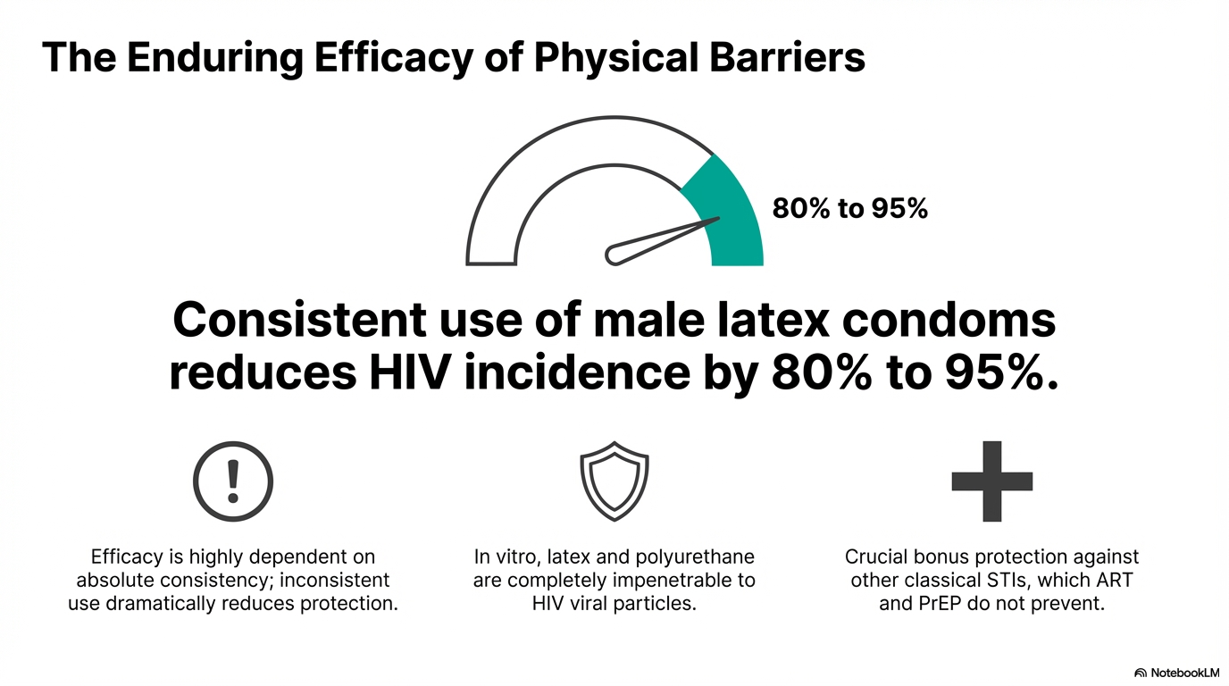

Slide 100
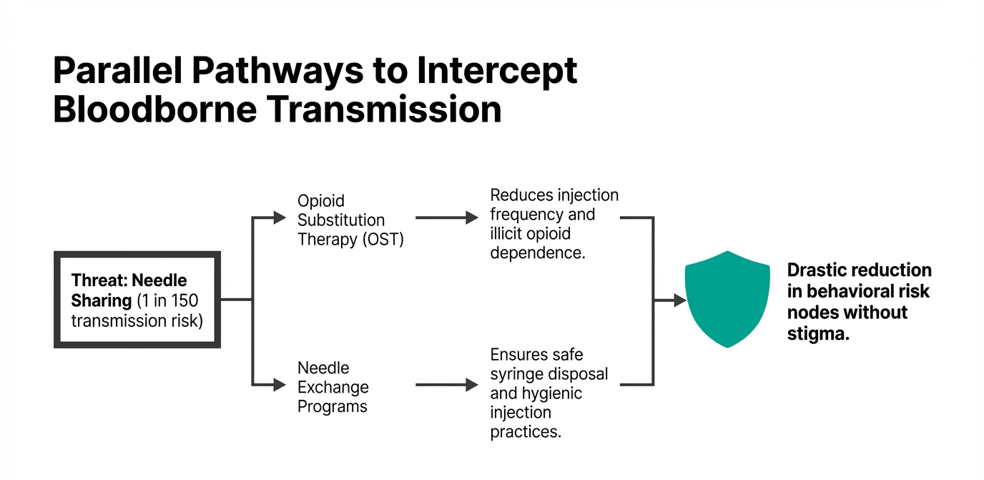
Notes:
Addiction treatment also associated with increased adherence to ART among infected individuals

Slide 101
Biomedical Prevention Strategies
Pre‑Exposure Prophylaxis (PrEP)
Post‑Exposure Prophylaxis (PEP)
Voluntary Medical Male Circumcision (VMMC)
STI management
Treatment as Prevention (TasP)

Slide 102
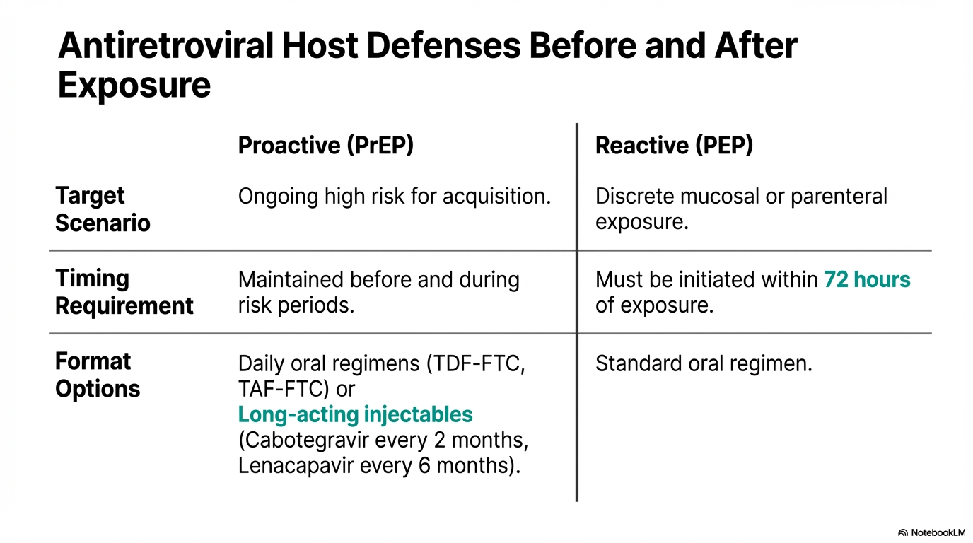

Slide 103
Pre‑Exposure Prophylaxis (PrEP) (TRUVADA TDF/FTC)
Prerequisites before starting PrEP:
Confirmed HIV‑negative status (rapid test before initiation).
High risk of HIV exposure (e.g., serodiscordant couples, sex workers, MSM, people who inject drugs, adolescent girls/young women in high‑burden areas).
Normal renal function (baseline creatinine/eGFR before TDF‑based PrEP).
No contraindications to PrEP drugs (e.g., severe kidney disease).
Counseling and informed consent (understanding adherence, side effects, and follow‑up).
Baseline tests recommended:
  HIV test, Hepatitis B surface antigen (HBsAg),Creatinine/eGFR, Pregnancy test (for women of childbearing age)
Follow‑up: HIV test every 3 months, renal monitoring every 6–12 months
Notes:
Tanzania’s HIV prevention guidelines emphasize a combination approach: condom use, voluntary testing, ART for all, PMTCT, harm‑reduction, and male circumcision. The new WHO recommendations (2025) add long‑acting injectable PrEP (lenacapavir, twice yearly) as a major innovation alongside oral PrEP and other biomedical strategies.

Slide 104
Post‑Exposure Prophylaxis (PEP) (TLD)
Prerequisites before starting PEP:
Recent high‑risk exposure (sexual, occupational, needle‑stick, blood exposure).
Presentation within 72 hours of exposure (critical window).
Baseline HIV test (to exclude pre‑existing infection).
Assessment of exposure type and source risk (HIV status of source if known).
Baseline labs (if available): renal and liver function, pregnancy test.
Counseling: importance of adherence to 28‑day regimen, side effects, follow‑up testing.
Follow‑up HIV testing: at 6 weeks, 3 months, and 6 months post‑exposure

Slide 105
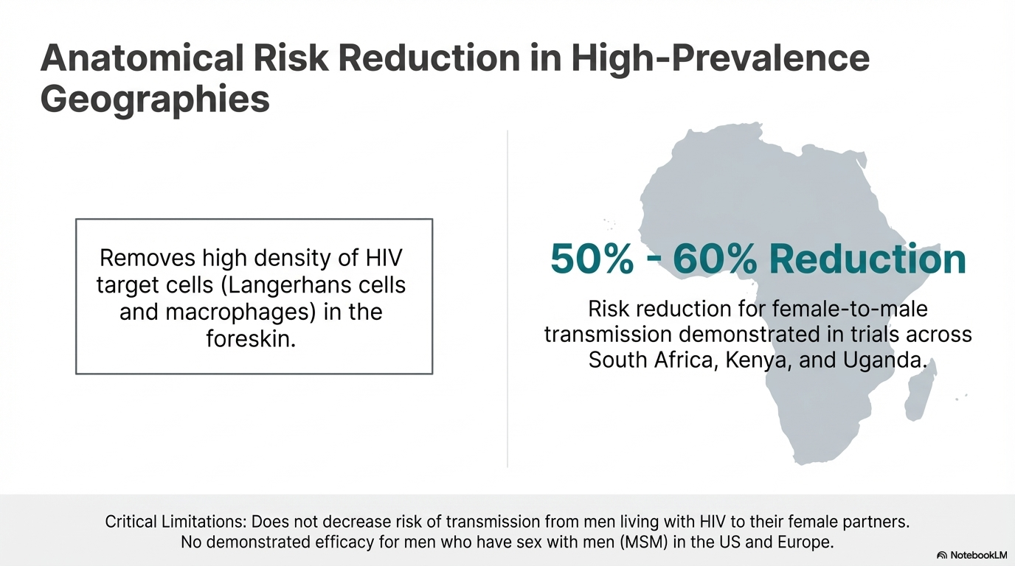
Voluntary Medical Male Circumcision (VMMC)

Slide 106
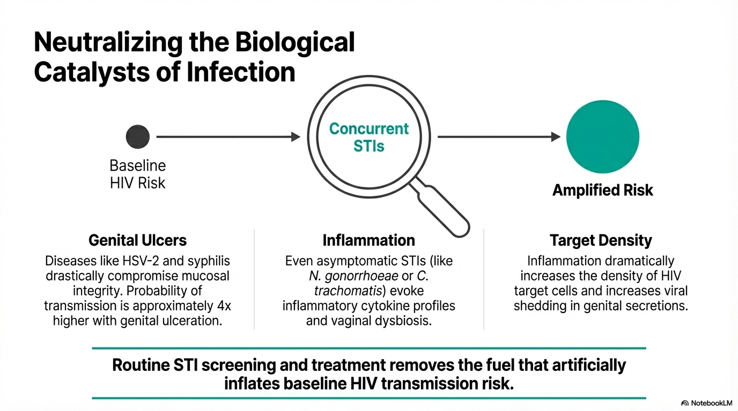

Slide 107

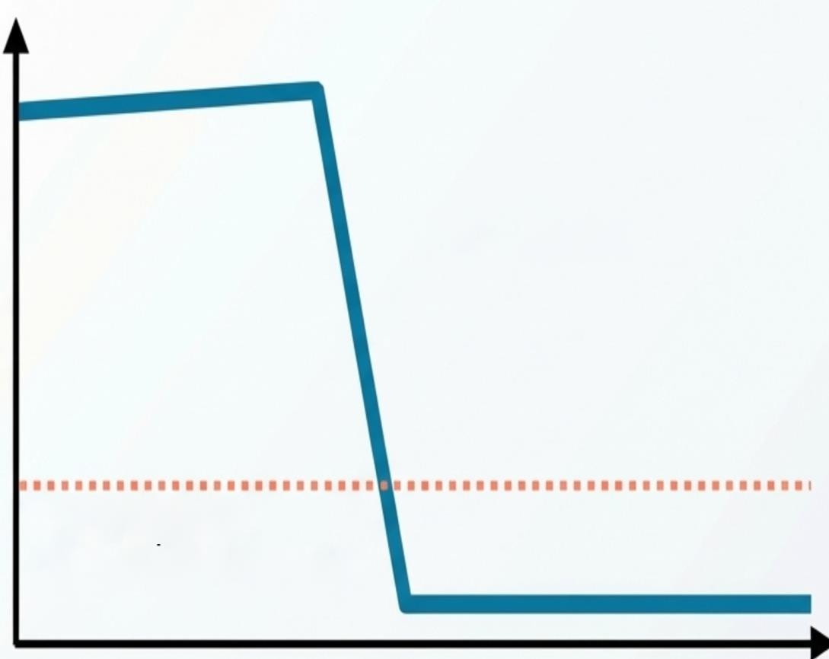

Treatment as Prevention (TasP)
Undetectable = Untransmittable (U=U)
HPTN 052 Study: 93% risk reduction with early ART initiation among 1,763 Sero discordant couples.
Viral Load
ART Initiation
PARTNER Study: Zero linked transmissions recorded over 7 6,000 condomless sex acts when the partner living with HIV was virologically suppressed.
<1,000 copies/mL
(The Transmission Threshold)
Time
Stable viral suppression demonstrates zero risk of linked HIV transmission.

Slide 108
Prevention of Mother‑to‑Child Transmission (PMTCT)
Transmission may occur during pregnancy, delivery, or breastfeeding
Strategies
  Antenatal HIV testing
  Maternal antiretroviral therapy
  Infant prophylaxis and early diagnosis

Slide 109
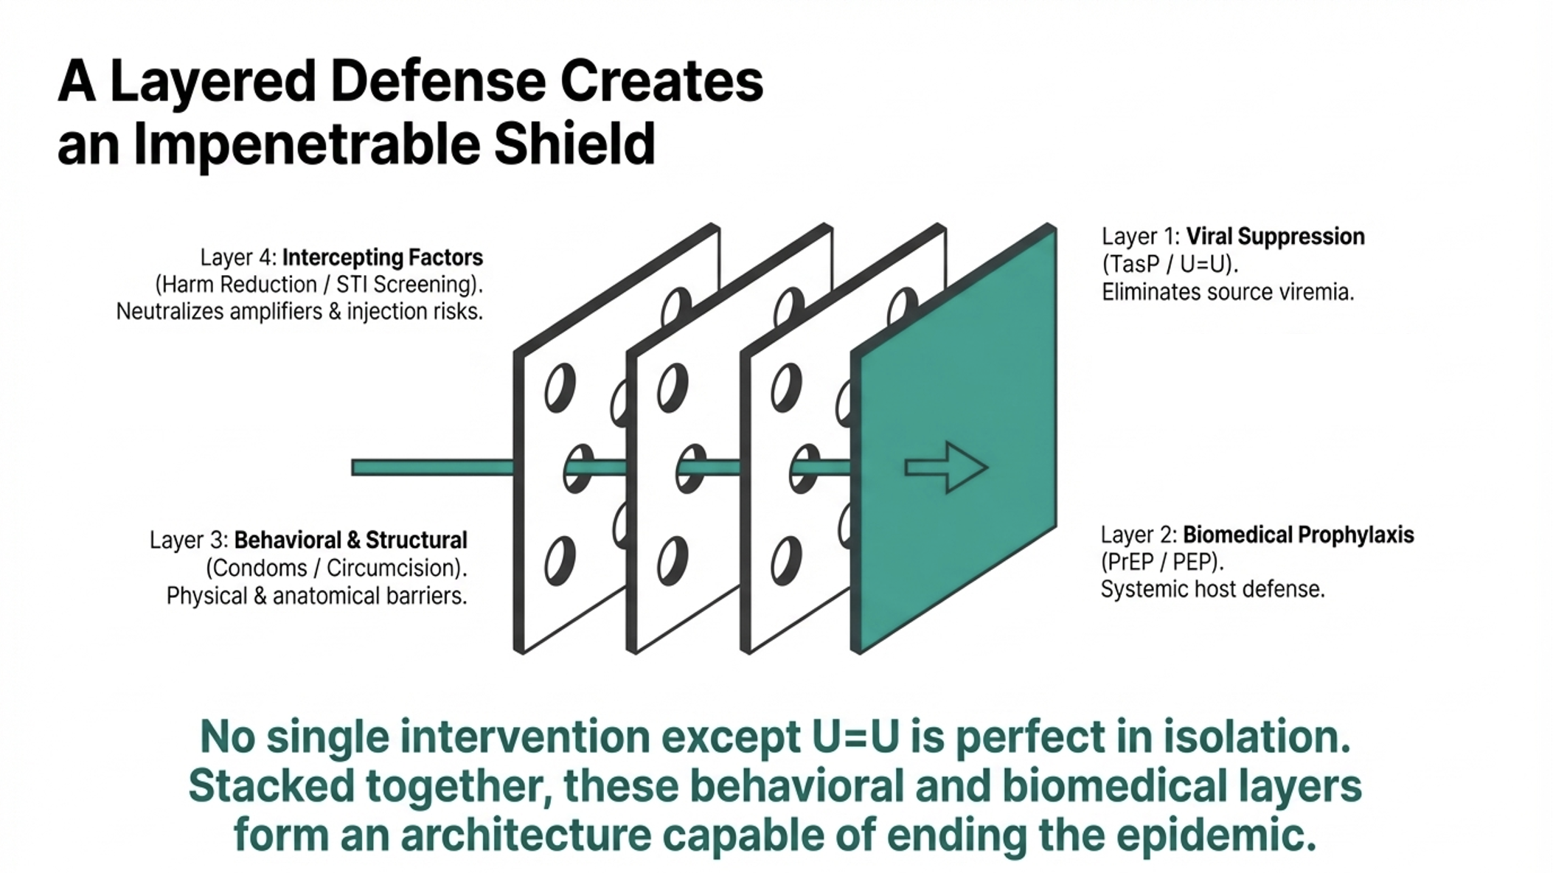

Slide 110
TB & HIV CO-INFECTION
HIV fuels the TB epidemic worldwide.
High prevalence of HIV among TB patients.
In Tanzania, ~50% of TB patients are co‑infected with HIV (NTLP estimate).
Among PLHIV, 5–10% develop TB.
TB is the leading cause of death in people living with HIV

Slide 111
TB/HIV Interaction
Impact of HIV on TB:
HIV is the strongest known risk factor for developing TB.
HIV accelerates progression from latent TB infection to active TB.
HIV increases the risk of recurrent TB after previous treatment.
HIV weakens immune responses (especially CD4⁺ T cells), making TB harder to control.
HIV can alter TB presentation, leading to atypical or extrapulmonary TB.

Slide 112
Impact of TB on HIV
TB is the most common opportunistic infection in people living with HIV (PLHIV).
TB infection accelerates HIV disease progression by increasing viral replication and immune activation.
TB is a leading cause of death among PLHIV globally.
TB treatment can interact with ART, complicating management (e.g., rifampicin reduces levels of some antiretroviral drugs).
Co-infection increases risk of immune reconstitution inflammatory syndrome (IRIS) when ART is initiated.
Key Points for Clinical Practice:
Early TB screening in PLHIV is critical.
ART initiation improves TB outcomes and reduces TB incidence in HIV patients.
Integrated TB/HIV care improves survival and reduces morbidity.

Slide 113
TPT
For adults and adolescents living with HIV, three months of weekly isoniazid and rifapentine (3HP) is the suggested preferred shorter-course regimen.
Six or nine months of daily isoniazid (6H/9H) remain effective alternative options, though they are associated with lower completion rates and higher toxicity.
Other WHO-recommended options include 1HP (one month of daily isoniazid and rifapentine), 3HR (three months of daily isoniazid and rifampicin), and 4R (four months of daily rifampicin) based on programmatic needs or clinical contraindications.
The 3HP regimen is compatible with once-daily DTG without requiring dose adjustments, which simplifies its implementation
Regimens containing rifampicin (such as 3HR) and 1HP require doubling the DTG dose to 50 mg twice daily

Slide 114
Metabolic Health Risk with Modern ART
There is a significant association between body weight gain and the use of Integrase Strand Transfer Inhibitors (INSTIs), particularly dolutegravir (DTG), and Tenofovir Alafenamide (TAF).
Boosted Protease Inhibitors (PIs) and TAF are linked to an increased risk of dyslipidemia, requiring careful management in patients with existing cardiovascular risk factors.
Physicians should regularly monitor weight, BMI, blood pressure, glucose, and lipids to evaluate the metabolic consequences of these ART regimens
WHO Guideline updates suggests:
  All PLHIV ≥40 years → consider statin, even with low risk
  Prioritize those with ≥5% risk
This reflects:
  HIV itself increases CVD risk (~2× higher)
  Traditional calculators underestimate risk in PLH
The REPRIEVE study found that a daily statins reduces the risk of major adverse cardiovascular events(MACE) by 35% in PLHIV with low to moderate traditional risk score.

Slide 115
When to Start Statins in PLHIV (WHO-aligned updates)
Age ≥40 years on ART
  Start statin if 10-year ASCVD risk ≥5%
  Use moderate-intensity statin
ASCVD risk <5%
  Consider statin if HIV-related risk enhancers:
    Long duration of HIV
    Low CD4 (<350)
    Prior viremia / poor adherence
    Hepatitis C coinfection
High-risk groups (treat regardless of HIV)
  ASCVD risk ≥20% → high-intensity statin
  LDL ≥4.9 mmol/L (≥190 mg/dL)
  Diabetes (age 40–75)

Slide 116
Statin therapy in PLHIV cont…
Age <40 years
  No routine statin use
  Focus on lifestyle & risk factor control
Drug interactions with ART
  Avoid: Simvastatin, Lovastatin (with boosted PI)
  Preferred:
    Pitavastatin (least interactions)
    Atorvastatin / Rosuvastatin (dose-adjust)

Slide 117
Reference:
WHO Consolidated Guidelines (2021): World Health Organization. Consolidated guidelines on HIV prevention, testing, treatment, service delivery and monitoring: recommendations for a public health approach. Geneva: World Health Organization; 2021. ISBN 978-92-4-003159-3.
WHO Updated Recommendations (2025): World Health Organization. WHO updated recommendations on HIV clinical management: recommendations for a public health approach. Geneva: World Health Organization; 2025. ISBN 978-92-4-011946-8.
NATIONAL GUIDELINES FOR THE MANAGEMENT OF HIV AND AIDS
Mandell, Douglas, and Bennett’s Infectious Disease ESSENTIALS
UpTodate

Slide 118


